Slide 1




ABC CALL VOLUME ANALYSIS
Divyasri Jegan

Slide 2

”Call trend analysis of ABC Company
Analysis is based on the dataset provided and strategies to solve the given task and make a valuable insights from it..

Slide 3
PROJECT DESCRIPTION
A Customer Experience (CX) team plays a crucial role in a company. They analyze customer feedback and data, derive insights from it, and share these insights with the rest of the organization. This team is responsible for a wide range of tasks, including managing customer experience programs, handling internal communications, mapping customer journeys, and managing customer data, among others.
In the current era, several AI-powered tools are being used to enhance customer experience. These include Interactive Voice Response (IVR), Robotic Process Automation (RPA), Predictive Analytics, and Intelligent Routing.
One of the key roles in a CX team is that of the customer service representative, also known as a call center agent. These agents handle various types of support, including email, inbound, outbound, and social media support.
Inbound customer support, which is the focus of this project, involves handling incoming calls from existing or prospective customers. The goal is to attract, engage, and delight customers, turning them into loyal advocates for the business.

Slide 4
BUSINESS UNDERSTANDING
Advertising is a crucial aspect of any business. It helps increase sales and makes the audience aware of the company's products or services. The first impressions of a business are often formed through its advertising efforts.
The target audience for businesses can be local, regional, national, or international. Various types of advertising are used to reach these audiences, including online directories, trade and technical press, radio, cinema, outdoor advertising, and national papers, magazines, and TV.
The advertising business is highly competitive, with many players bidding large amounts of money to target the same audience segment. This is where the company's analytical skills come into play. The goal is to identify those media platforms that can convert audiences into customers at a low cost.

Slide 5
APPROACH
01 - DATA PREPROCESSING
Data preprocessing is done to read and know about the dataset before diving into analysis and also to find the error,null values all sort of data is being handled.
02 - TECH STACK USED
Tools to implement the result and analysis of clients queries
Providing solution to my task and making a helpful insights for better decision making.
03 - ANALYSIS
Result and conclusions of the clients need and solution to my project .
04 - RESULTS

Slide 6
PROJECT TIMELINE
Handling and reading the dataset to process the dataset and provide insights from it
Call Volume Analysis
Night Shift Manpower Planning:
Can you create a chart or graph that shows the number of calls received in each time bucket?
Propose a manpower plan for each time bucket throughout the day, keeping the maximum abandon rate at 10%.
Data
read
TASK 2
TASK 4
Dataset
TASK 1
TASK 3
The given dataset
about the
Call volume
trend analysis link
dataset
Average Call Duration
Manpower Planning
What is the average duration of calls for each time bucket?
What is the minimum number of agents required in each time bucket to reduce the abandon rate to 10%?

Slide 7

TECH
STACK
USED
GOOGLE SHEETS
Google sheets were used in excelling and to make interactive charts for elaborative output and to perform data analysis in it.
GOOGLE SLIDES
Google slides helped in presentation regarding the project .

Slide 8

ANALYSIS

Slide 9
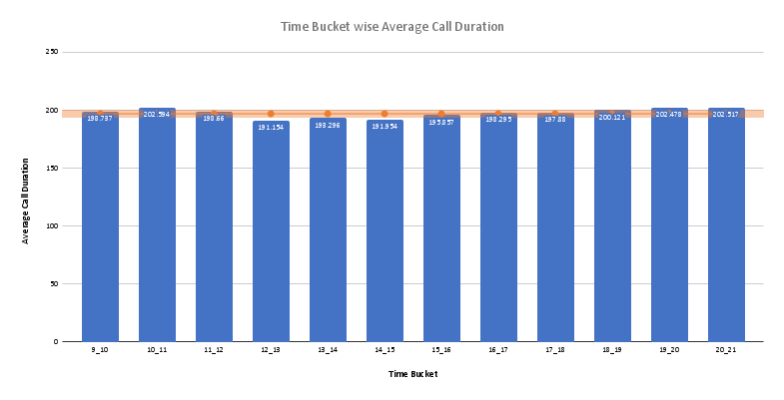
Average Call Duration: Determine the average duration of all incoming calls received by agents. This should be calculated for each time bucket. Your Task: What is the average duration of calls for each time bucket?
The overall Average Call Duration is 196.963 seconds.
We can observe that the Average Call Duration first peaks in the morning hours before dropping to below average value during the lunch hours and then again increasing to above average value.

Slide 10
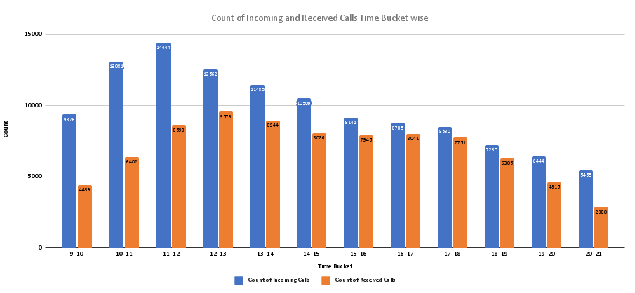
Call Volume Analysis: Visualize the total number of calls received. This should be represented as a graph or chart showing the number of calls against time. Time should be represented in buckets (e.g., 1-2, 2-3, etc.). Your Task: Can you create a chart or graph that shows the number of calls received in each time bucket?
We can observe that the number of received calls received first increases with time before dropping down.
We can also observe that the number of abandoned calls are very high in the morning hours and as the day progresses, the number of abandoned calls reduces.
03 - SOCIAL MEDIA

Slide 11
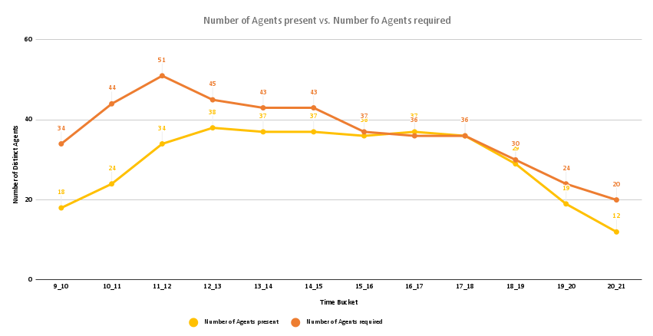
Manpower Planning: The current rate of abandoned calls is approximately 30%. Propose a plan for manpower allocation during each time bucket (from 9 am to 9 pm) to reduce the abandon rate to 10%. In other words, you need to calculate the minimum number of agents required in each time bucket to ensure that at least 90 out of 100 calls are answered. Your Task: What is the minimum number of agents required in each time bucket to reduce the abandon rate to 10%?
We can observe that to maintain a maximum of 10% abandon rate, we need to increase the availability of agents in the morning hours by a large margin as in these hours, the number of incoming calls are quite high and the number of agents available currently are quite low.
During afternoon hours and during late evening hours, we need to increase the availability of agents by a slight margin to maintain a maximum of 10% abandon rate.

Slide 12
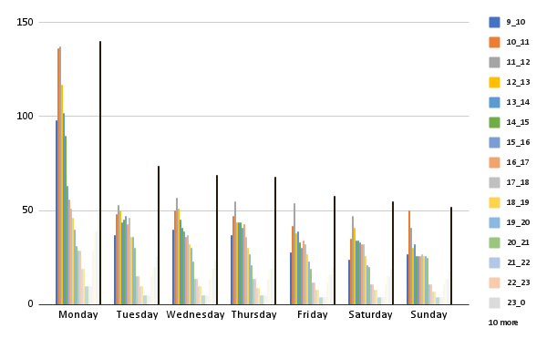
Night Shift Manpower Planning: Customers also call ABC Insurance Company at night but don't get an answer because there are no agents available. This creates a poor customer experience. Assume that for every 100 calls that customers make between 9 am and 9 pm, they also make 30 calls at night between 9 pm and 9 am. The distribution of these 30 calls is as follows: Your Task: Propose a manpower plan for each time bucket throughout the day, keeping the maximum abandon rate at 10%.Assumptions: An agent works for 6 days a week; On average, each agent takes 4 unplanned leaves per month; An agent's total working hours are 9 hours, out of which 1.5 hours are spent on lunch and snacks in the office. On average, an agent spends 60% of their total actual working hours (i.e., 60% of 7.5 hours) on calls with customers/users. The total number of days in a month is 30.
From the above heatmap, we can observe that for day of the week, Monday requires the most number of agents in individual time buckets as well as for the overall day as it is starting of the week.
For rest of the days, agent requirement remains more or less the same with Saturday’s and Sunday‘s requirement on the lower side as they are weekends.
For individual time buckets, the most number of agents required is in the morning hours from 9 A.M to 1 P.M and the least number of agents required is at night hours from 12 A.M to 5 P.M.

Slide 13
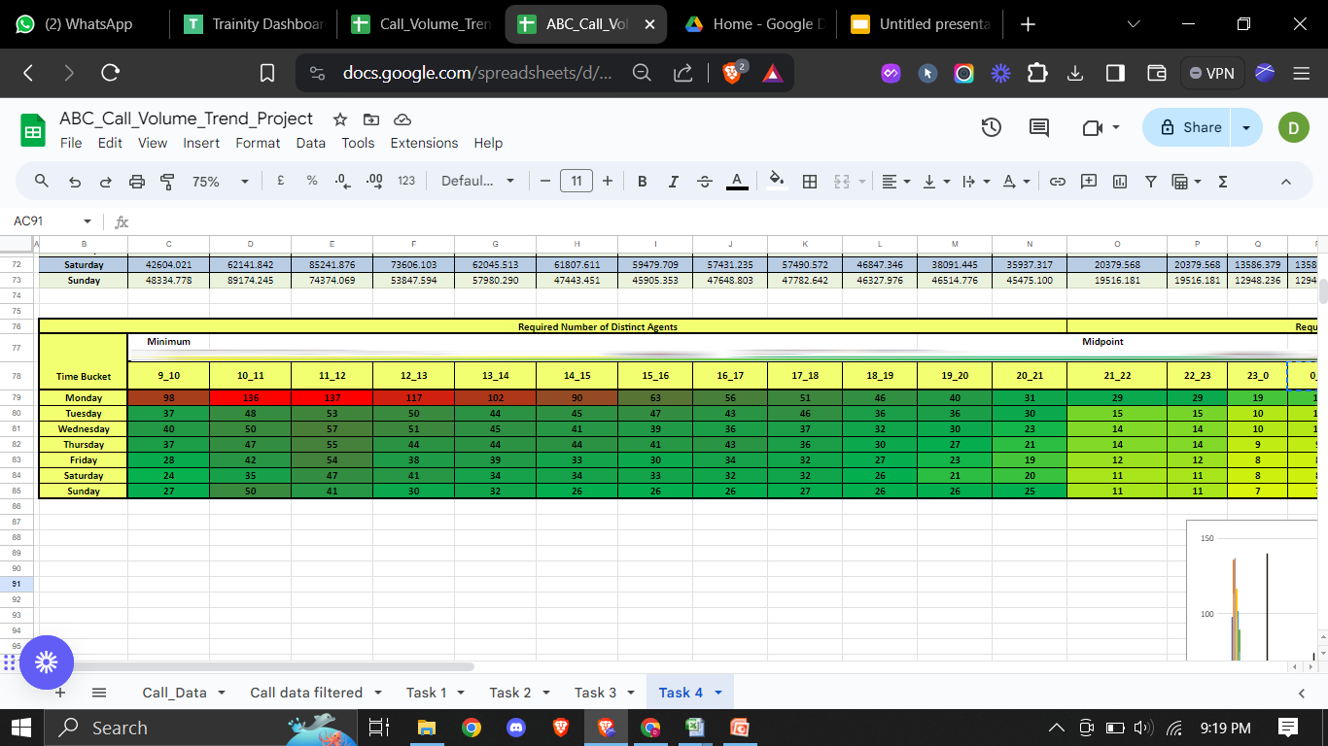

Slide 14
RESULT
Through this project ,I was able to understand the importance of
Data analysis in the call trend analysis.
Provided the insights regarding the dataset gives the solution to the project and help me to improve my knowledge regarding it.
Links:
spreadsheet

Slide 15
THANK YOU

